Slide 1
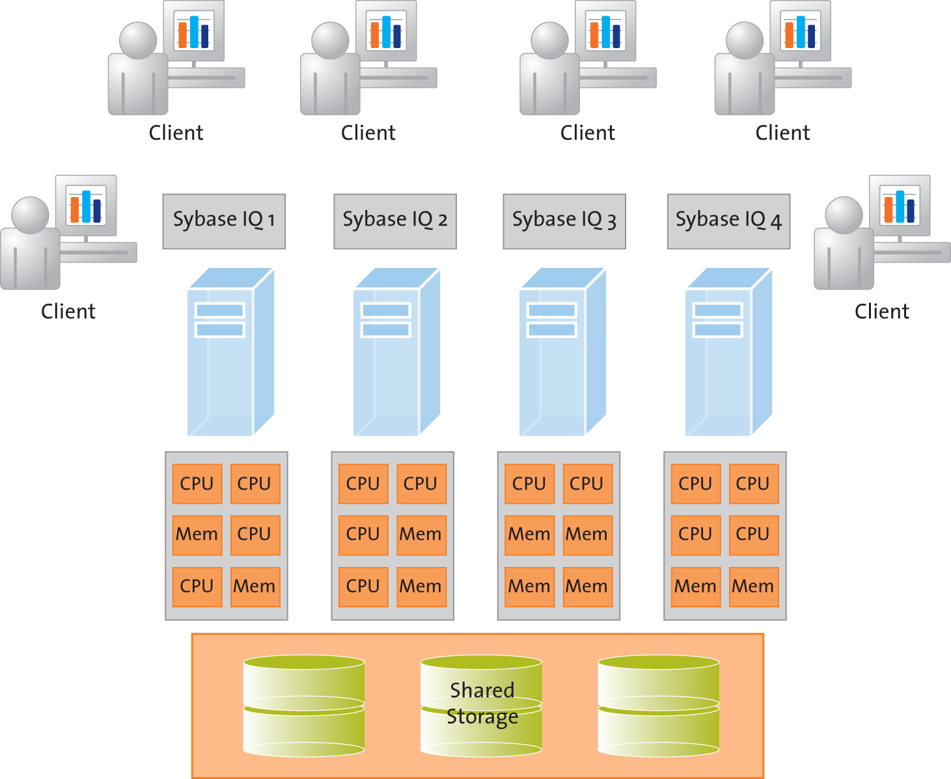
Block Diagram for Project Sybase IQ

